Slide 1
RoadVision DUET Vehicle Detection
Team: Backprop SUST
YOLO-based vehicle detection for Bangladesh CCTV traffic scenes
A data-driven object detection pipeline built for dense mixed traffic, small vehicles, rare regional classes, and CCTV domain shift.
#11
#25
mAP@0.50
PUBLIC RANK
PRIVATE RANK
EVAL METRIC
Score: 0.62279
Score: 0.59821
13 Classes

Slide 2
PROBLEM OVERVIEW
Problem and Dataset Structure
Objective
Dataset at a Glance
Detect and classify every vehicle in Bangladesh highway surveillance images.
810
10,475
TRAIN IMAGES
TRAIN ANNOTATIONS
Required Prediction Per Object
Class ID
Confidence score
Normalized X center
Normalized Y center
Normalized width
Normalized height
327
13
TEST IMAGES
VEHICLE CLASSES
4
12.93
CAMERA SOURCES
AVG OBJECTS / IMAGE
11
38
MEDIAN OBJECTS / IMG
MAX OBJECTS IN ONE IMG

Slide 3
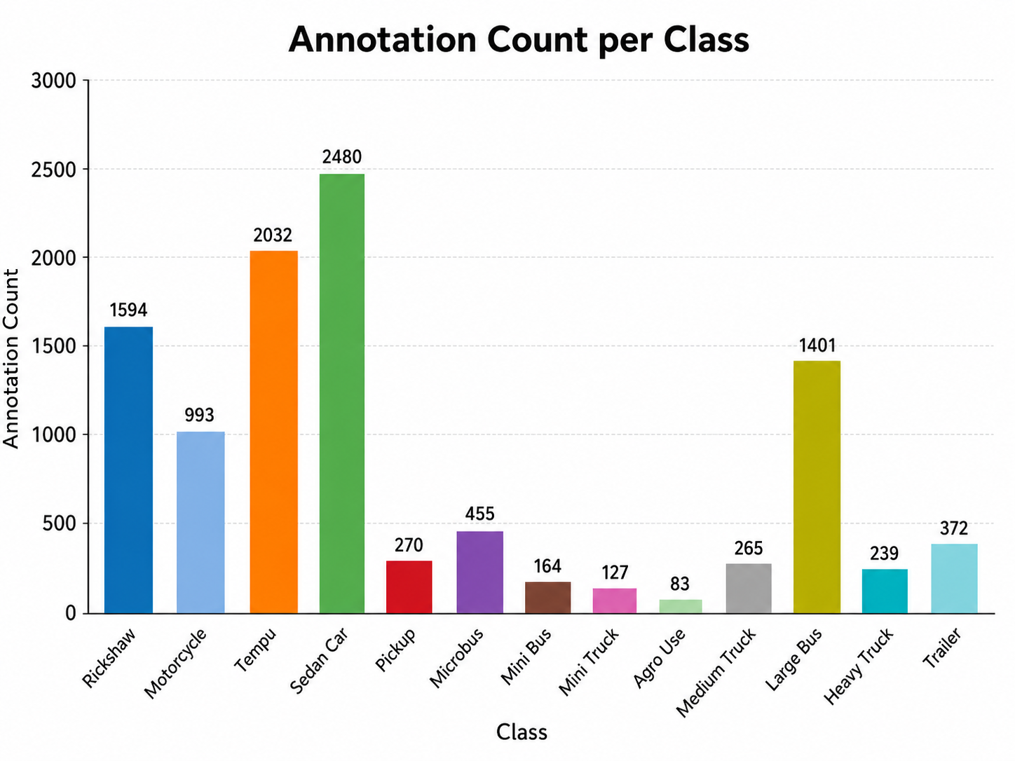
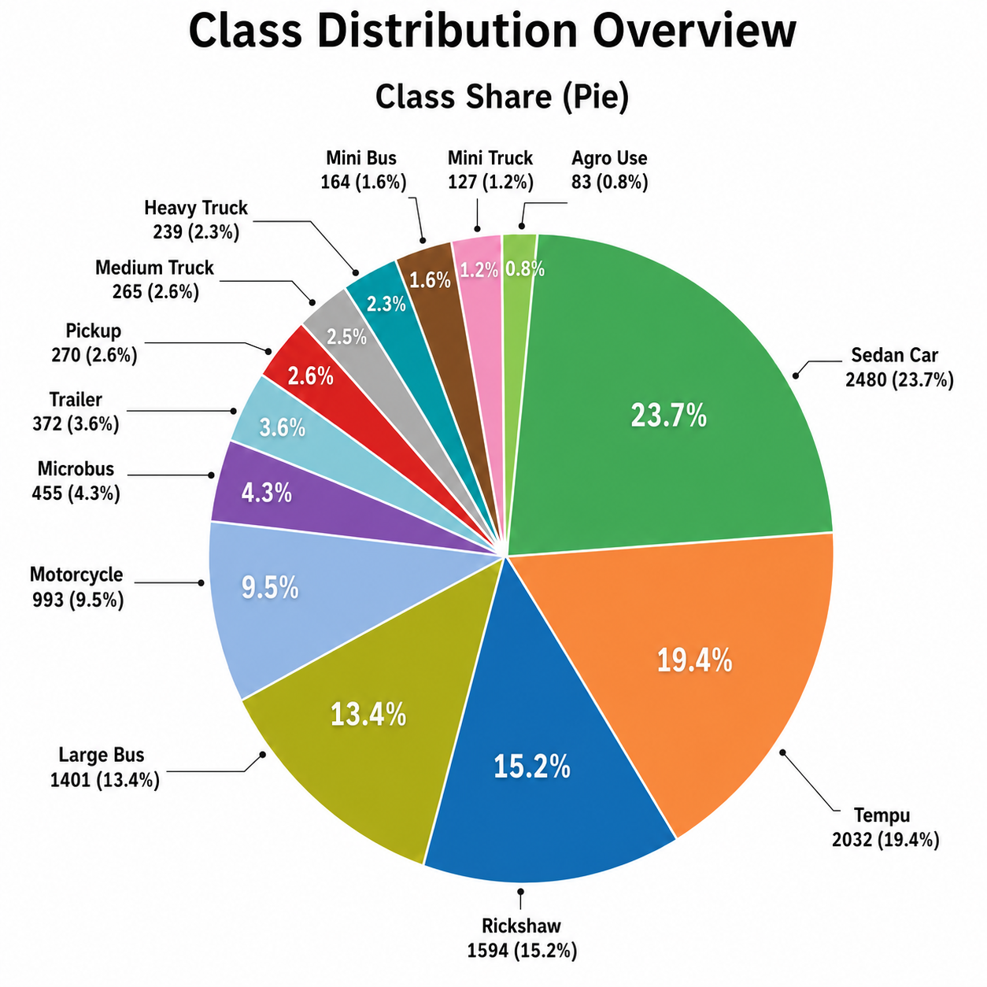
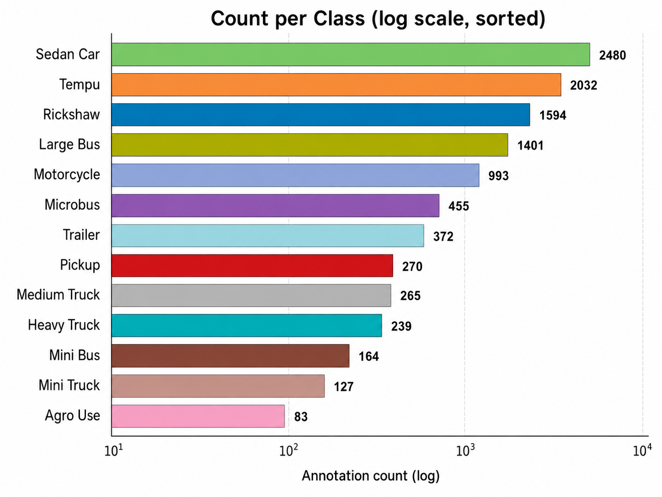
EDA FINDING 1
Severe Class Imbalance
Annotation count per class
Class share by proportion
Log-scale ranking: full imbalance gap
Most Frequent
Least Frequent
Imbalance Ratio
Shannon Entropy
Sedan Car
Agro Use
29.88×
3.063 / 3.700 bits
2,480 annotations · 23.68%
83 annotations · 0.79%
Sedan Car vs Agro Use
82.8% of max entropy

Slide 4
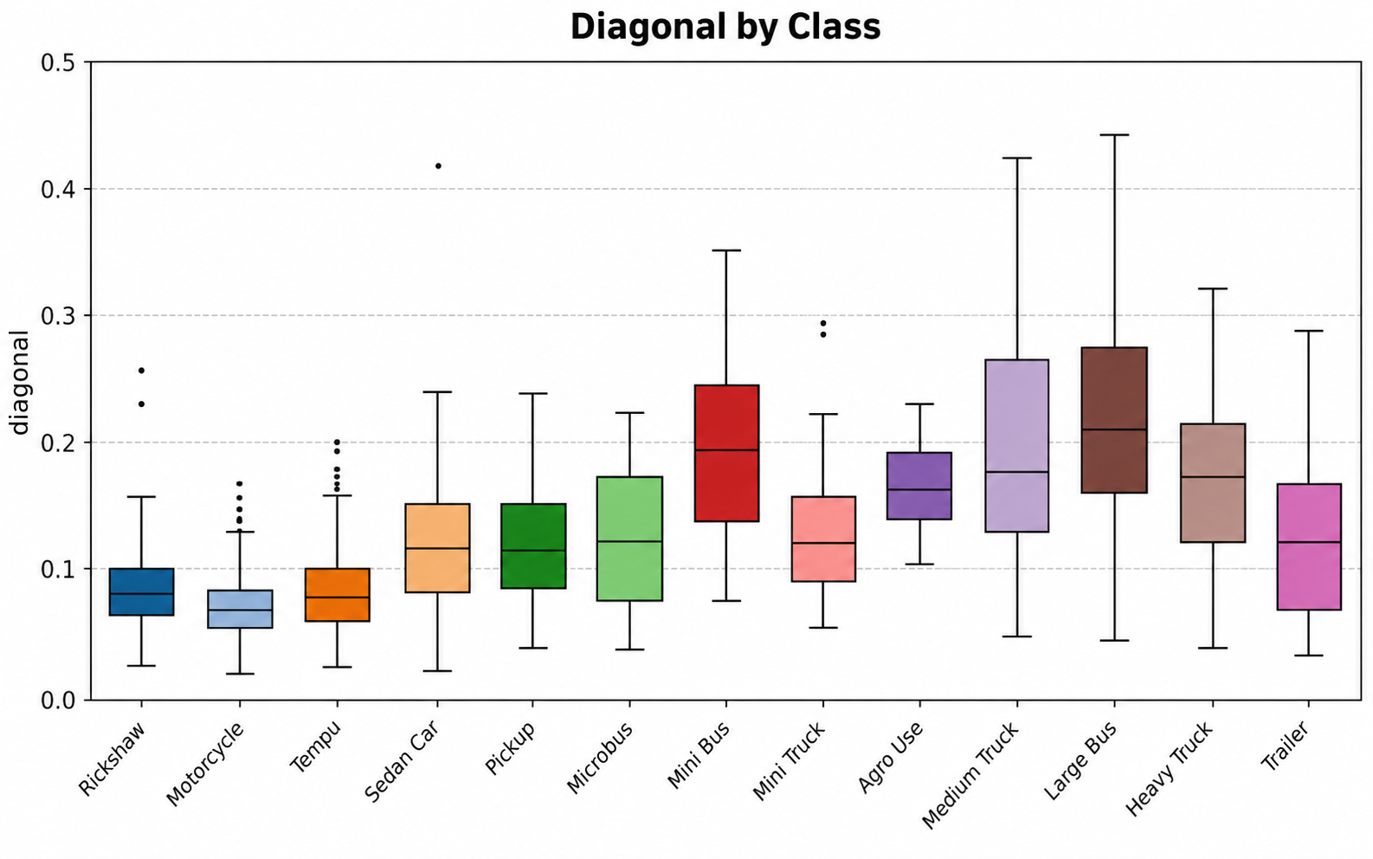
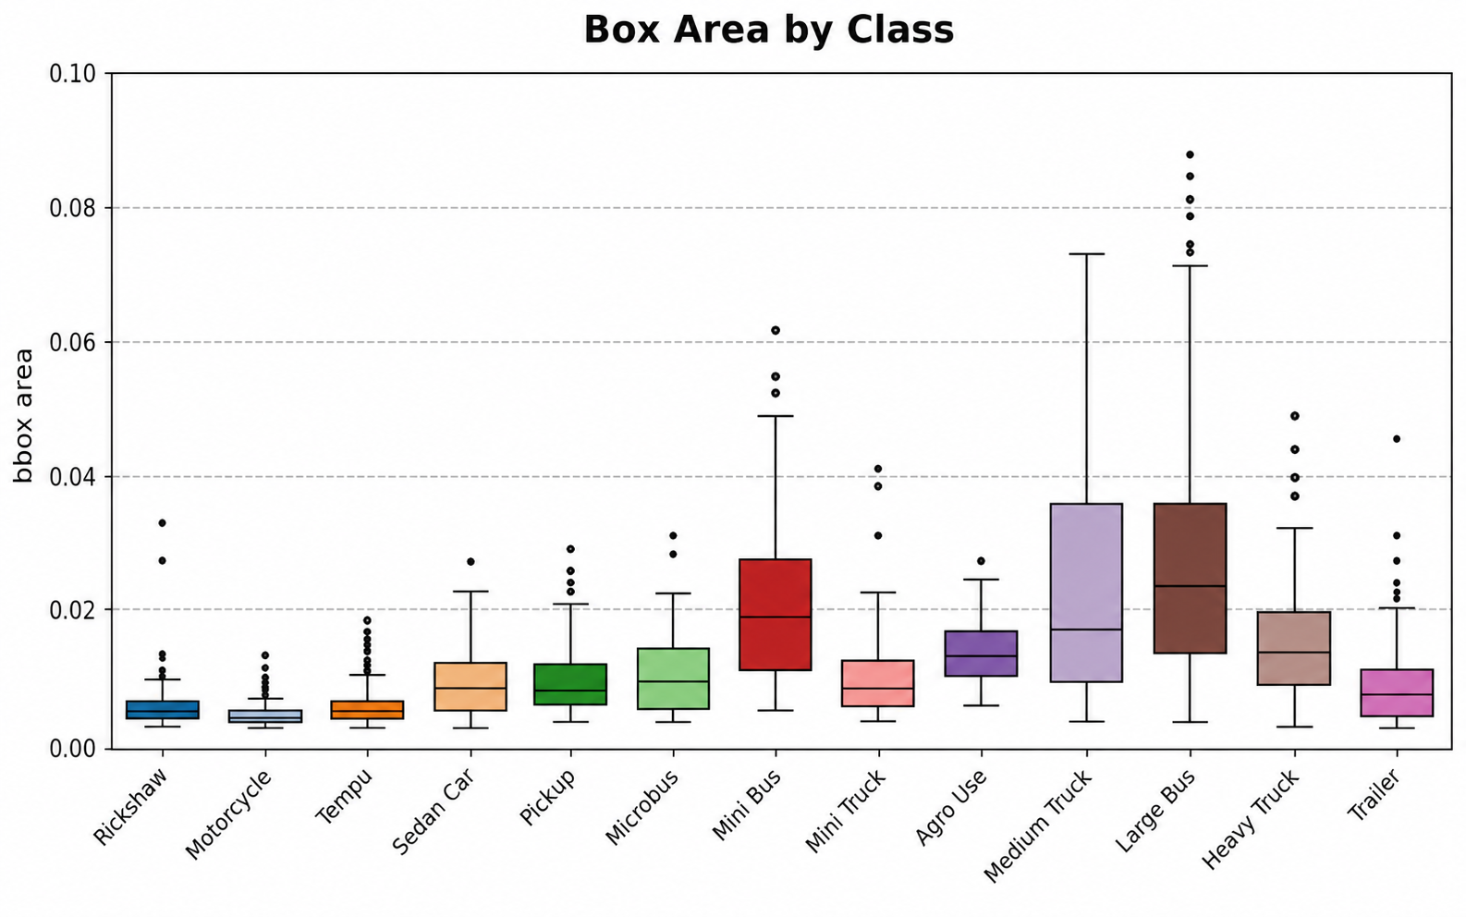
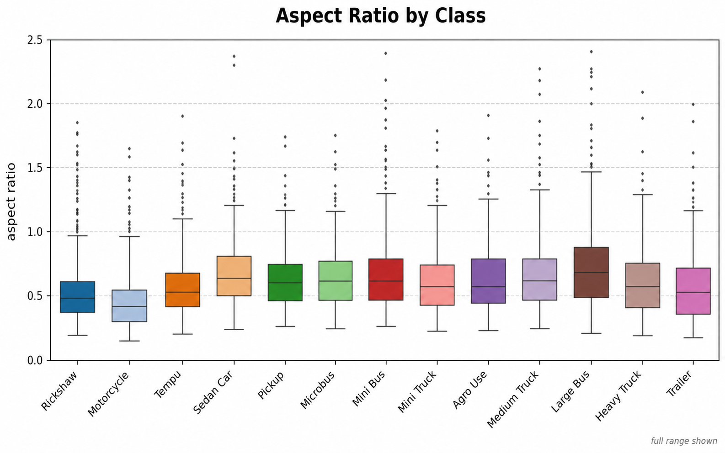
EDA FINDING 2
Box Geometry Creates Detection Difficulty
Diagonal by class
Bounding box area by class
Aspect ratio by class
0.00862
0.00421
120
64
MEAN BOX AREA
MEDIAN BOX AREA
TINY BOXES (<0.0005 AREA)
CLIPPED BOUNDARY BOXES
Size Spread
Main Takeaway
Smallest footprint — Motorcycle. Largest — Large Bus and Medium Truck. Trailer, Mini Truck, Microbus, Sedan Car, and Pickup overlap in geometry range.
Model must handle very small distant vehicles and larger overlapping categories simultaneously. Supports 1280 training, robust augmentation, and careful post-processing.

Slide 5
MODELING STRATEGY
EDA Guided the Full Modeling Strategy
EDA SIGNAL
EDA SIGNAL
Class imbalance
Small object geometry
Sedan Car — 2,480 annotations; Agro Use — 83
Median width 0.046, minimum width 0.006
→ Rare class handling and copy-paste augmentation
→ 1280 image size and SAHI tiled inference
EDA SIGNAL
EDA SIGNAL
Dense traffic scenes
Box overlap and class similarity
Avg 12.93 objects/image; max 38
Multiple classes share similar area, aspect ratio, and diagonal ranges
→ Mosaic, MixUp, and recall-preserving inference
→ Careful merging, low confidence preservation, validation-based review

Slide 6
METHODOLOGY
Training and Inference Pipeline
Data Audit
YOLO Conversion
Augmentation
Model Training
Validation
Inference
Submission
Data Audit
Training Setup
Inference
810 train images parsed, 10,475 annotations
0 missing values, 0 duplicate rows
Class IDs verified 0–12
Bounding boxes clipped to valid range
Ultralytics YOLO framework
BNVD YOLOv8 weights
Image size: 1280 · Batch: 8 · Seed: 42
Epochs: 60 · Early stopping patience: 15
Standard full-image inference
SAHI tiled inference (640×640, 25% overlap)
Low confidence threshold to protect recall
327-row output verified, 0 empty predictions
Precision 0.804
Recall 0.742
mAP50 0.815
mAP50-95 0.556

Slide 7
FINAL RESULTS
Results, Limitations, and Final Takeaway
#11
#25
327
0
PUBLIC RANK
PRIVATE RANK
FINAL TEST ROWS
EMPTY OUTPUTS
Score: 0.62279
Score: 0.59821
Verified outputs
100% coverage
Limitations
Integrity
2-day window limited deeper tuning
External datasets not used
Synthetic augmentation can't replace real rare class variety
SAHI improves recall but increases inference time
No manual test data labeling
No leaked labels used
Submission fully automated by pipeline
Final Takeaway
Every major decision came from EDA — imbalance drove rare class handling, small geometry drove 1280 + SAHI, dense scenes drove Mosaic + MixUp, and box overlap drove careful post-processing. Built for recall, robustness, and valid submission in Bangladesh CCTV traffic detection.

